Slide 1
Ant on a cube
Siddhant Kulkarni

Slide 2
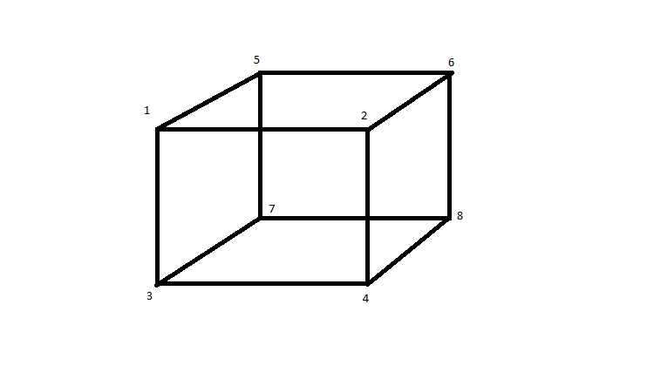
Start with Visualization of the Cube
I visualized the cube as shown below

Slide 3
Foundations of the Solutions
CubeEdge Enumerator – Provides an enumeration of the edges.
Cube – Responsible for providing attributes of the cube.
Ant – Responsible for travelling on the cube until it reaches the opposite edge from where it started.
AntOnACube – Responsible for triggering the simulations.
I verified that this foundation was working by having one ant at a time travel from each edge and verifying that the path they took was a valid path.

Slide 4
Running multiple simulations simultaneously
Simulation – Responsible for executing a simulation as a thread of execution.
InfoTracker – Responsible for updating captured statistics by each simulation in a synchronized manner.
The code is designed to perform multiple simulations on the same cube.
These classes allow for execution of multiple simulations in parallel while maintaining the integrity of the statistics being captured.

Slide 5
Where to find stable results?
Initial results with a small number of simulations showed a large variance.
I executed a number of simulations 3 times to identify at what point the results started to stabilize.

Slide 6
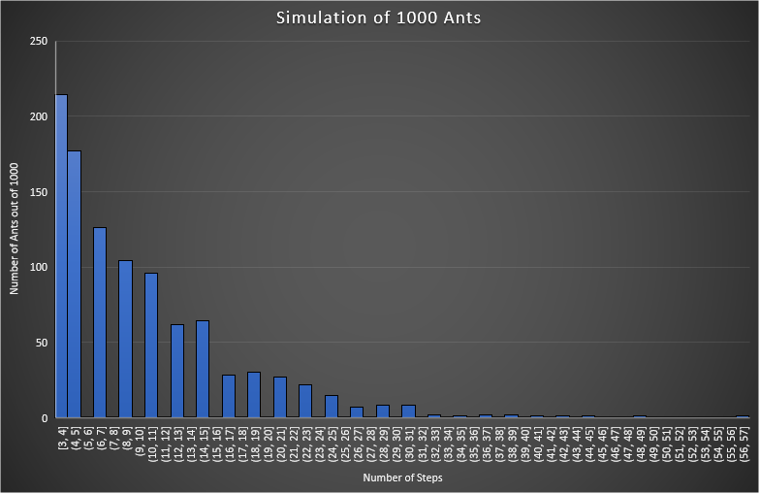
A side observation
I was also interested in finding out the distribution of ants and the number of steps it took them to reach the opposite edge.

Slide 7
Results of Simulations
Execution ID | Average Time | Max Time
1 | 9.992814 | 115
2 | 10.006152 | 121
3 | 9.996832 | 133
4 | 10.011802 | 101
5 | 10.003786 | 115
6 | 9.989668 | 105
7 | 9.99057 | 117
8 | 9.998964 | 131
9 | 9.995938 | 107
10 | 9.99851 | 111
Average: | 9.9985036 | 115.6
Based on initial experiments, it is clear that we get fairly stable results with 1,000,000 simulations.
I executed 10 iterations of 1,000,000 simulations to achieve these results:

Slide 8
Conclusions
Mean time required for ants to reach the opposite edge = 9.9985036
Since it takes 1 second for an ant to travel from one edge to another, we can say that the average/mean time is ~10 seconds.
Mode time required for ants to reach the opposite edge = 3
As seen in the graph on slide 6, 3 is the most common number of steps taken by an ant to reach the opposite edge.
Mean Max time required for ants to reach the opposite edge = 115.6

